Slide 1


CSMSS
Chh. Shahu College of Engineering,
Chhatrapati Sambhajinagar
Department of Artificial Intelligence and Data Science
A.Y.: 2024 – 2025
Infant Cry Classification System
Dr. BABASAHEB AMBEDKAR TECHNOLOGICAL UNIVERSITY, Lonere
Guide Name: Prof.Moin
Name Of Team Member 1 : Mayur Dadasaheb Kale (AI 3070)
Name Of Team Member 2 : Piyush Santosh Jadhav (AI 3028)

Slide 2

Content:
Introduction
Project Working
Technical Stack
Webpage Visual
Conclusion

Slide 3
Introduction:
In today’s world, ensuring the care and well-being of infants is a top priority, and crying remains one of the primary ways infants communicate their needs. However, interpreting the cause of a cry—whether due to hunger, discomfort, sleepiness, or pain—can be difficult and time-consuming, especially for stressed or sleep-deprived caregivers. To address this, the Infant Cry Detection System has been developed using advanced Deep Learning algorithms that analyze acoustic features like pitch, tone, frequency, and intensity to accurately classify different types of cries. The system continuously learns and improves with more data, becoming increasingly personalized to an individual infant’s cry patterns. This not only enhances caregiver responsiveness but also enables long-term tracking of sleep and health trends, making the system valuable for both parents and healthcare professionals in monitoring a baby’s overall well-being.

Slide 4
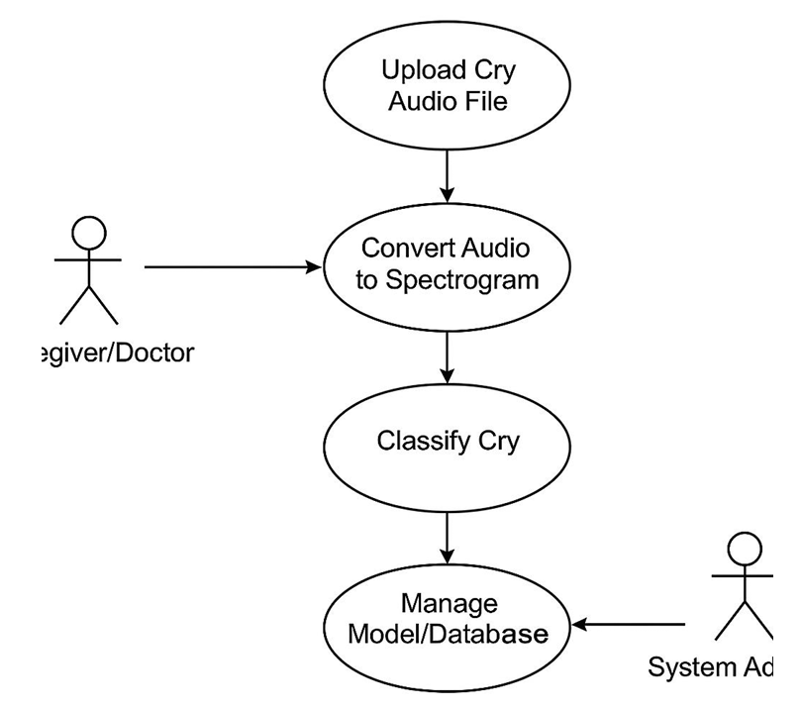
Project Working:
Capture Cry: Record infant cry audio.
Augmentation: Enhance audio with variations.
Spectrogram Conversion: Convert audio to spectrogram and save as PNG.
Model Selection: Use a pre-train deep learning model.
Training & saving: Train the model and save the best-performing version.
Evaluation & Prediction: Evaluate model accouracy and use it to predict cry types.

Slide 5
Technical Stack:
Python
ML & DL Algorithm
Librosa
HTML, CSS, JS
Flask
ML Libraries
Audio Libraries (Wave / Soundfile / Pydub)

Slide 6
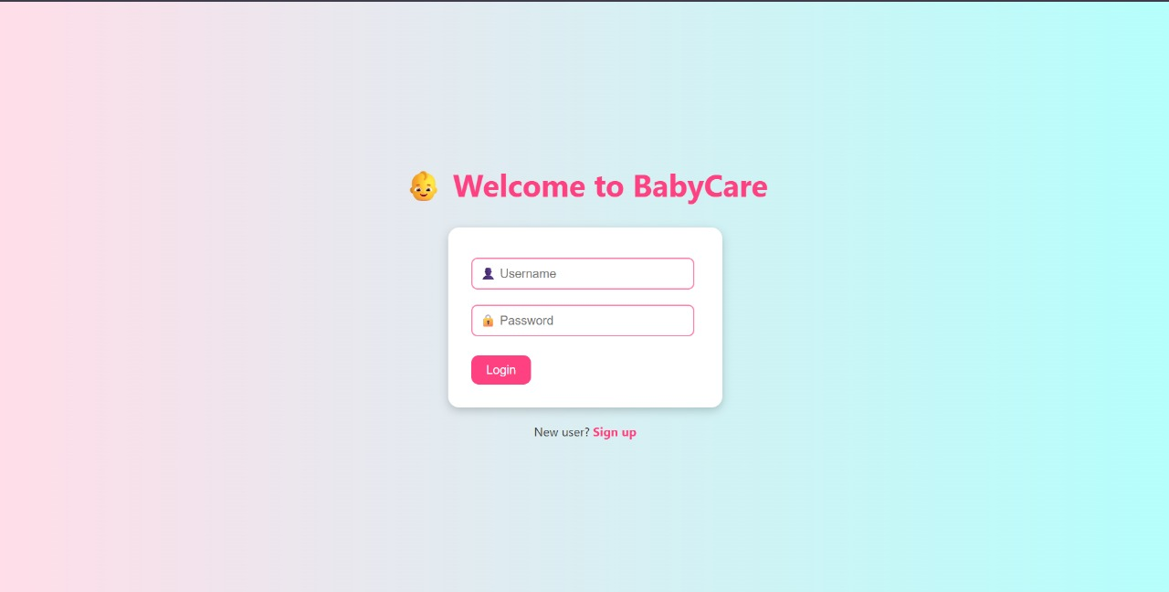
Webpage Visual:

Slide 7

Output

Slide 8
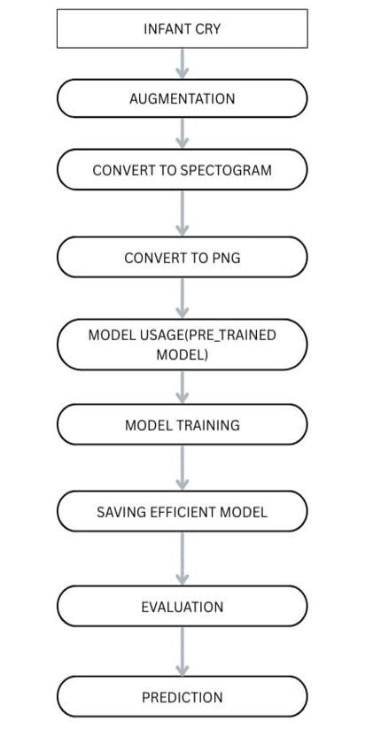
Flowchart

Slide 9
Conclusion
The Infant Cry Classification System successfully uses machine learning to identify different types of infant cries, such as hunger, pain, or discomfort. This helps caregivers respond more accurately to a baby's needs, enhancing early childcare. With further data and model improvements, the system can become a valuable tool in smart parenting and infant health monitoring.

Slide 10


